Slide 1
Module 10: Testing
A BPI Training Program
‹#›

Slide 2
Objectives
Day 1 - Introduction to Testing
And JUnit
Notes:
‹#›

Slide 3
Key Takeaways
Key Takeaways from the previous module (Spring Security Basics):
Authentication vs Authorization
Authentication: Verifies user identity (e.g., username/password)
Authorization: Determines user permissions (e.g., access to endpoints/resources)
Roles
Define access levels (e.g., ADMIN, USER)
Role-Based Access Control (RBAC) manages permissions
Can have fine-grained permissions beyond roles
Data Storage for Security
Database-backed authentication: Persistent storage, maintainable
In-memory authentication: Hard-coded users, useful for testing or demos
Spring Security Basics
Security filters: Authentication → Authorization
Password encoding: Use BCryptPasswordEncoder, never plaintext
Method-level security: @PreAuthorize, @Secured annotations
Best Practices
Apply authentication and authorization logic as needed
Encrypt/encode credentials
Maintain clear role hierarchies
Regularly review roles and permissions
Notes:
‹#›

Slide 4
Objectives
Learning Objectives:
By the end of this module, participants will be able to:
Learn what is testing and why testing matters
Write unit tests for service layer logic using JUnit 5 and Mockito.
Write integration tests for Spring Boot applications with @SpringBootTest.
Test controllers, services, and repositories effectively.
Follow best practices to create maintainable, reliable automated tests.
Avoid common pitfalls in Spring Boot testing.
Notes:
‹#›

Slide 5

Testing
What is Software Testing?
Software testing is the process of evaluating and verifying that a program or application behaves as expected.
It ensures the software meets requirements and works correctly under different conditions.
Notes:
‹#›

Slide 6
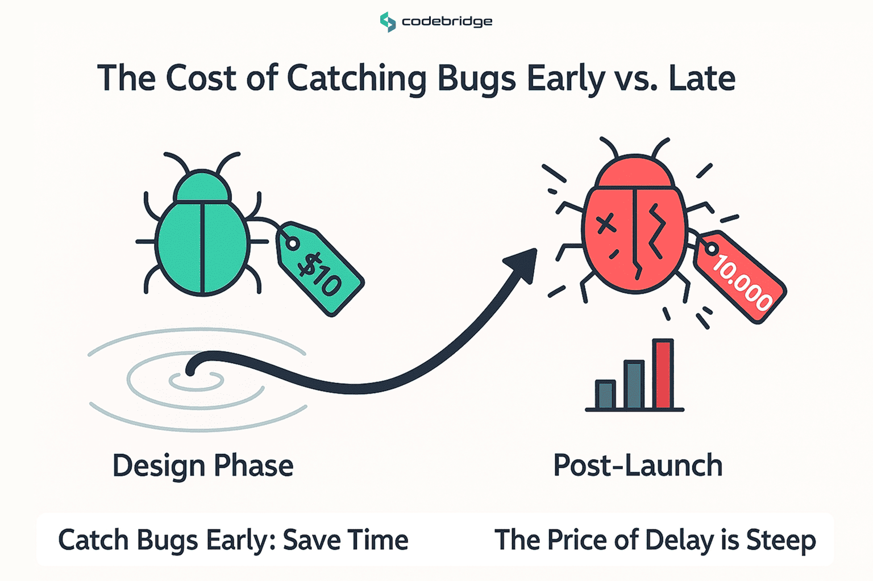
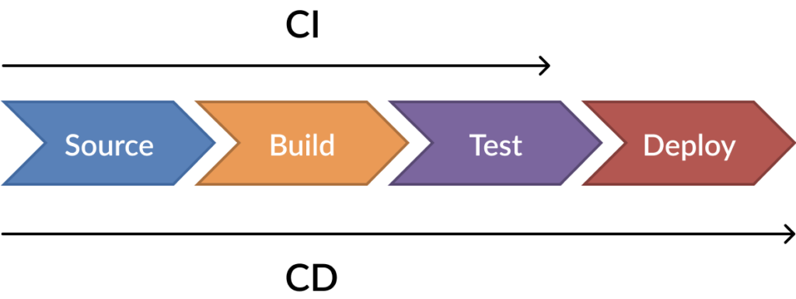
Testing
Why Testing Matters?
Detect bugs early → reduces cost of fixing in production
Ensures reliability and maintainability of code
Supports CI/CD pipelines and continuous feedback
Allows confident refactoring of existing code
Improves team productivity by reducing regression issues
Notes:
‹#›

Slide 7
Testing
Levels of Testing
Level | Focus | Tools / Annotations
Unit | Test individual methods/classes | JUnit 5, Mockito
Integration | Test components together, DB, REST | @SpringBootTest, TestRestTemplate
Web Layer | Test controllers & REST endpoints | @WebMvcTest, MockMvc
Repository | Test JPA repositories & DB queries | @DataJpaTest, Testcontainers
Notes:
‹#›

Slide 8
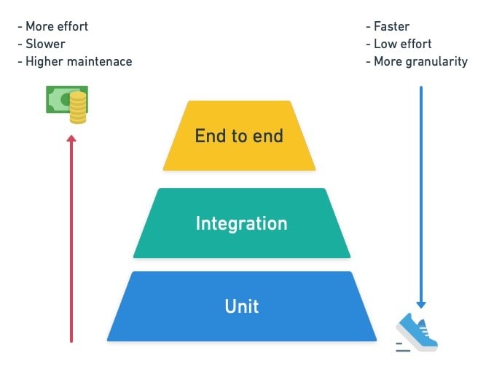
Testing
The Test Pyramid
Write more unit tests than integration tests
Integration tests verify interactions
Web layer / repository tests verify end-to-end correctness
Notes:
‹#›

Slide 9
Testing
Testing Methodologies
TDD (Test-Driven Development) – write tests before code
BDD (Behavior-Driven Development) – tests focus on system behavior
AAA Pattern (Arrange → Act → Assert)
Notes:
‹#›

Slide 10
Testing
Test-Driven Development (TDD)
A development approach where tests are written before writing the actual code.
Ensures that code is testable, correct, and maintainable from the start.
Workflow (Red-Green-Refactor):
Red: Write a failing test for a new feature or functionality.
Green: Write just enough code to make the test pass.
Refactor: Clean up the code while ensuring tests still pass.
Key Benefit: Forces writing code only for tested functionality, reducing over-engineering.
Notes:
‹#›

Slide 11
Testing
Behavior-Driven Development (BDD)
Tests focus on the behavior of the system rather than implementation.
Often uses natural language descriptions of functionality (Given-When-Then).
Helps align developers, testers, and business stakeholders.
Workflow:
Given: Initial context or state
When: Action taken
Then: Expected outcome
Key Benefit: Makes tests readable by non-developers and focuses on what the system should do.
Notes:
‹#›

Slide 12
Testing
AAA Pattern - Arrange, Act, Assert
A structured pattern for writing unit tests.
Makes tests clear, readable, and consistent.
Steps:
Arrange: Set up objects, mocks, test data
Act: Execute the method or functionality under test
Assert: Verify the results are as expected
Key Benefit: Keeps tests organized, easy to read, and easy to maintain.
Notes:
‹#›

Slide 13
Testing
JUnit Overview
JUnit 5: Modern Java testing framework
Supports unit tests, parameterized tests, assertions, lifecycle hooks
Works well with Spring Boot (services, controllers, repositories)
Annotations: @Test, @BeforeEach, @AfterEach, @BeforeAll, @AfterAll
Assertions: assertEquals, assertTrue, assertThrows
Integrates with Mockito for mocking dependencies
Notes:
‹#›

Slide 14
Testing
@Test
Marks a method as a test method to be executed by JUnit.
@Test
void shouldAddNumbers() {
assertEquals(5, 2 + 3);
}
Notes:
Every test case must have @Test.
Can optionally specify @Test with assertThrows for exception testing.
Notes:
‹#›

Slide 15
Testing
@BeforeEach
Runs before each test method in the class.
Typically used for setup (initializing objects, mocks, test data).
@BeforeEach
void setUp() {
calculator = new Calculator();
}
Notes:
Ensures a fresh environment for each test.
Notes:
‹#›

Slide 16
Testing
@AfterEach
Runs after each test method.
Typically used for cleanup (closing connections, clearing data).
@AfterEach
void tearDown() {
calculator = null;
}
Notes:
Useful if tests modify shared resources that need resetting.
Notes:
‹#›

Slide 17
Testing
@BeforeAll
Runs once before all test methods in the class.
Typically used for expensive setup (DB connection, starting server).
@BeforeAll
static void initAll() {
System.out.println("Initialize resources before all tests");
}
Notes:
Method must be static in JUnit 5 unless using @TestInstance(Lifecycle.PER_CLASS).
Notes:
‹#›

Slide 18
Testing
@AfterAll
Runs once after all test methods in the class.
Typically used for cleanup after all tests (close DB, shutdown server).
@AfterAll
static void tearDownAll() {
System.out.println("Clean up resources after all tests");
}
Notes:
Method must be static in JUnit 5 unless using @TestInstance(Lifecycle.PER_CLASS).
Notes:
‹#›

Slide 19
Testing
@ExtendWith(MockitoExtension.class)
Integrates Mockito with JUnit 5.
Enables Mockito annotations like @Mock and @InjectMocks to work automatically.
Purpose in test:
Automatically initializes @Mock objects and injects them into @InjectMocks.
Removes the need to manually call MockitoAnnotations.openMocks(this).
Notes:
‹#›

Slide 20
Testing
@Mock
Creates a mock object for a dependency.
Mocks simulate behavior of real objects without requiring a database or service.
Purpose in test:
UserRepository, RoleRepository, PasswordEncoder are mocked so tests don’t hit the real DB or encrypt passwords.
Example:
@Mock
private UserRepository userRepository;
Notes:
‹#›

Slide 21
Testing
@InjectMocks
Creates an instance of the class under test and injects the mocked dependencies into it.
Purpose in test:
UserService is created with userRepository, roleRepository, and passwordEncoder mocked automatically.
Example:
@InjectMocks
private UserService userService;
Notes:
‹#›

Slide 22
Testing
Exercise #1: Create JUnit for UserService
You should have a simplified UserService that allows:
Creating users (createUser)
Checking for duplicate usernames
Assigning roles to users
Create unit test for those scenarios (both successful and failed)
Notes:
‹#›

